Slide 1



4 Lesson
Boolean operators, if else, while, for
Viktoriia Dvornyk
Date: 29-10-2022

Slide 2

Let's get it started

Slide 3

Content
Boolean operators
if else statements
while statement
break and continue
What is None?
for statement

Slide 4

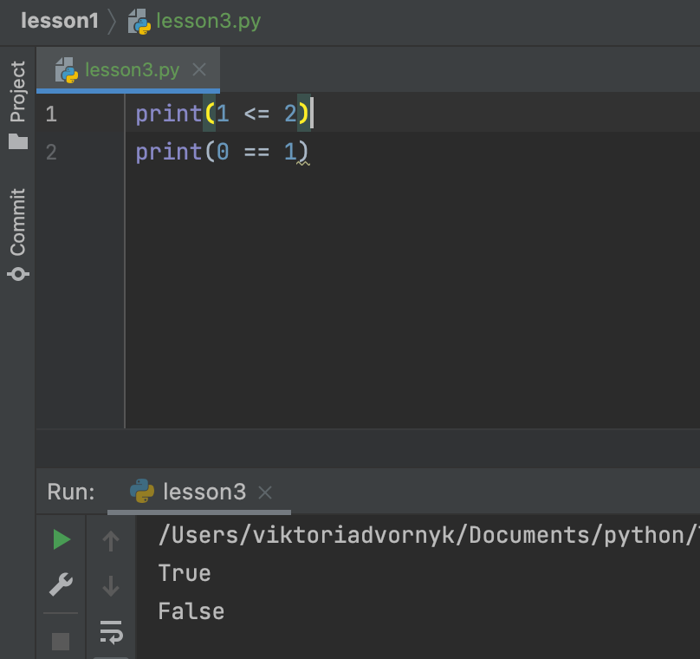
Boolean operators
The Python Boolean type is one of Python’s built-in data types
It’s used to represent the truth value of an expression
For example, the expression 1 <= 2 is True, while the expression 0 == 1 is False

Slide 5

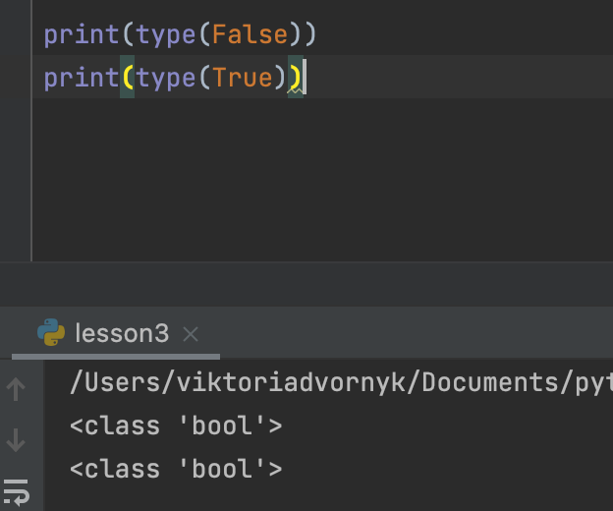
The Python Boolean Type
The Python Boolean type has only two possible values:
True
False
No other value will have bool as its type. You can check the type of True and False with the built-in type():

Slide 6
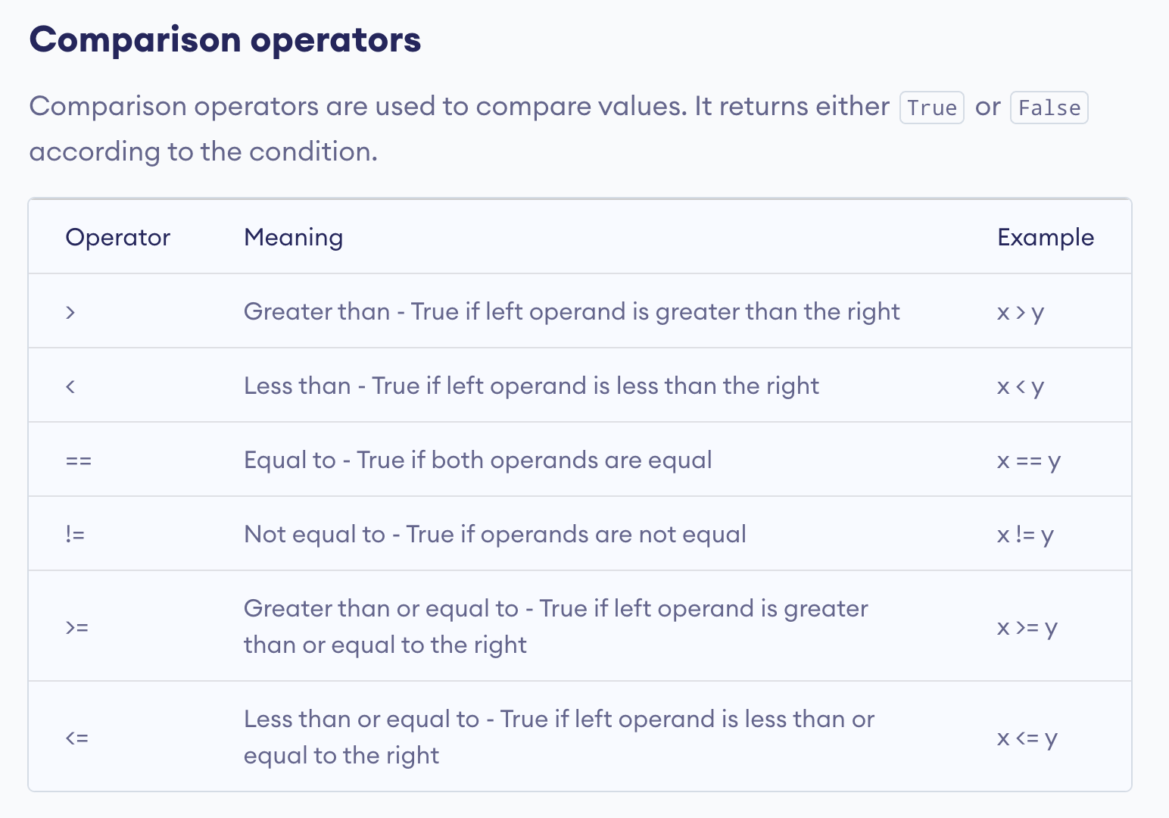

Slide 7
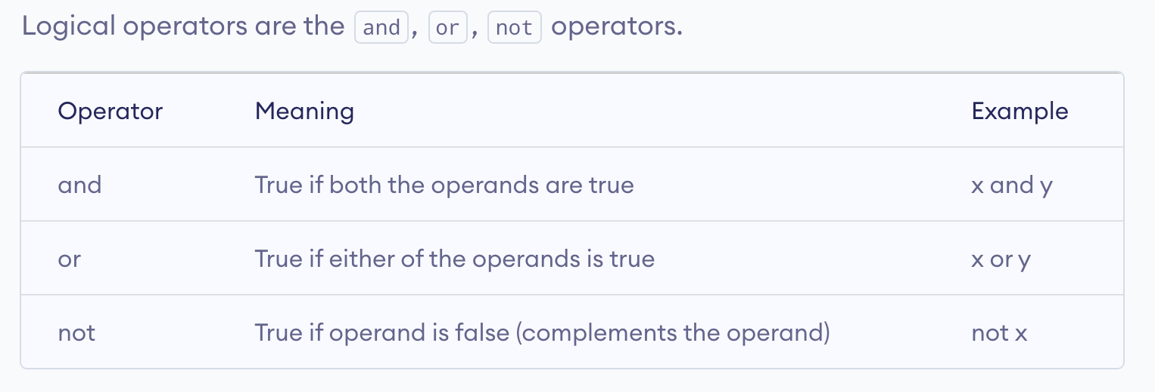

Slide 8
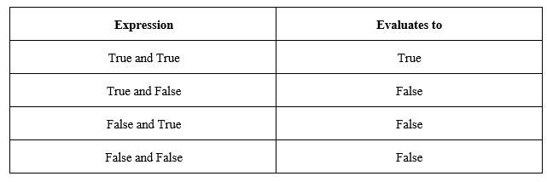
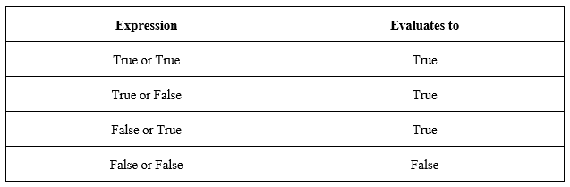
and
or

Slide 9
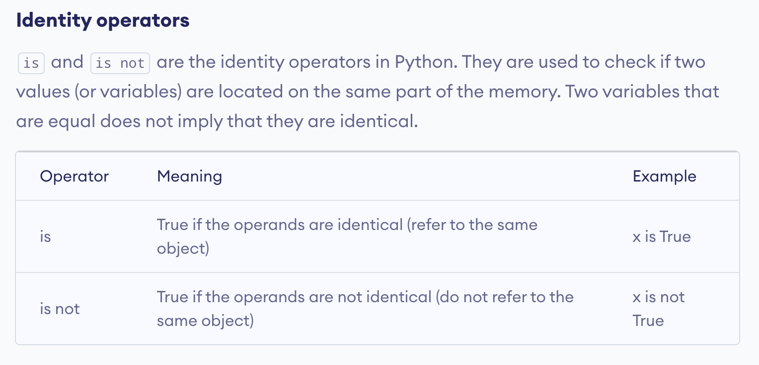

Slide 10
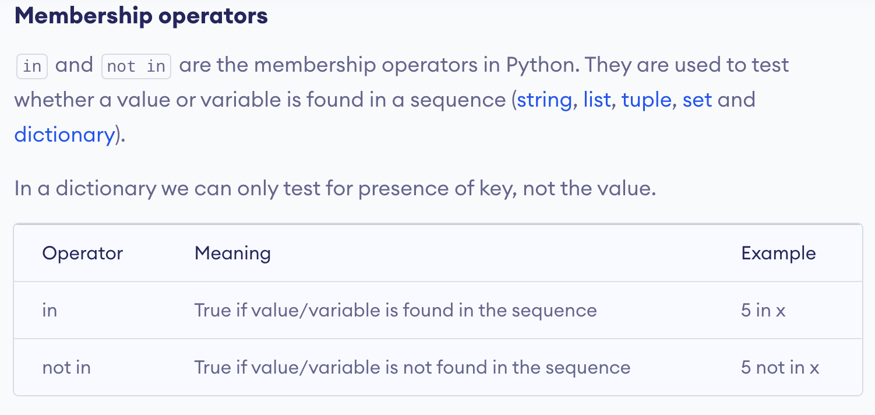

Slide 11

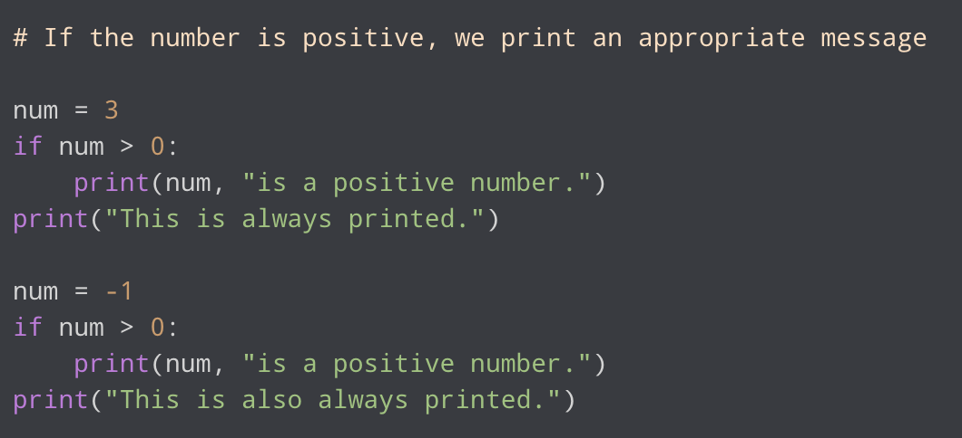
if statement
Decision making is required when we want to execute a code only if a certain condition is satisfied.
If the test expression is False, the statement(s) is not executed.
For example:

Slide 12

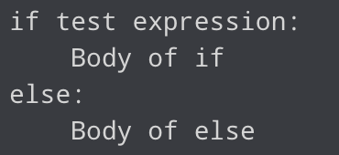
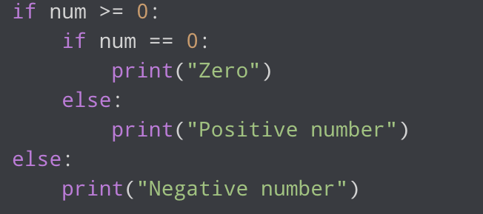
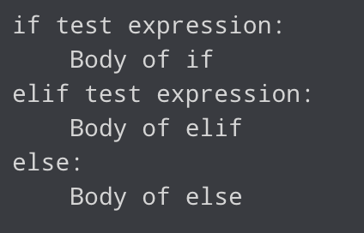
if … else
Nested if
if … elif … else

Slide 13
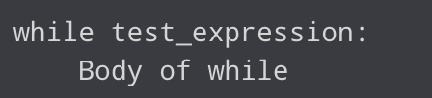
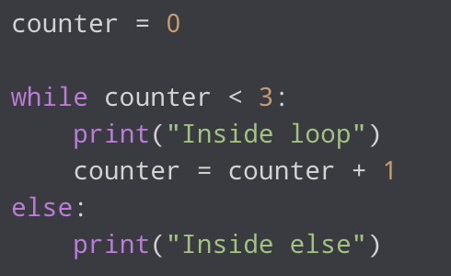
while statement
The while loop in Python is used to iterate over a block of code as long as the test expression (condition) is true
We generally use this loop when we don't know the number of times to iterate beforehand
Same as with for loops, while loops can also have an optional else block
The else part is executed if the condition in the while loop evaluates to False
While loop with else

Slide 14
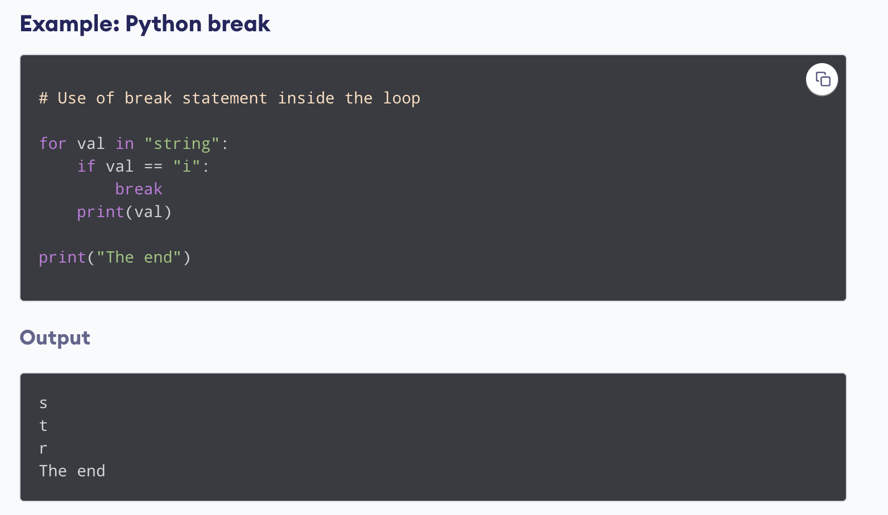
break and continue
Python break statement
The break statement terminates the loop containing it
If the break statement is inside a nested loop (loop inside another loop), the break statement will terminate the innermost loop

Slide 15
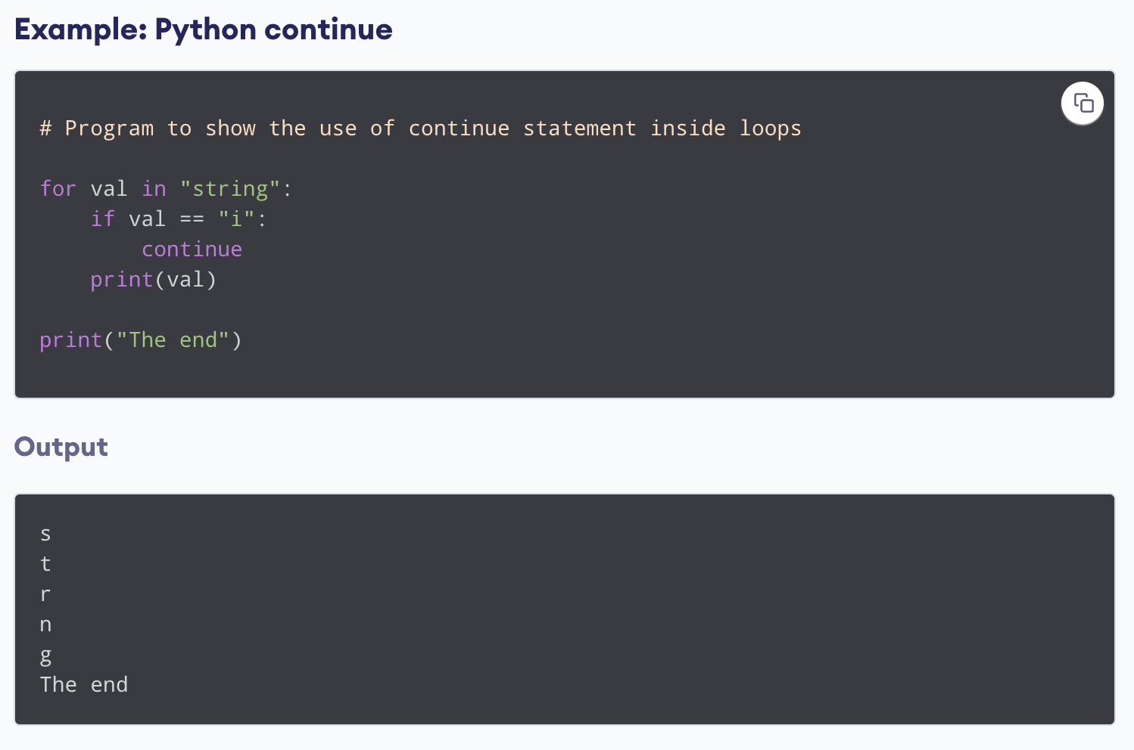
break and continue
Python continue statement
The continue statement is used to skip the rest of the code inside a loop for the current iteration only
Loop does not terminate but continues on with the next iteration

Slide 16
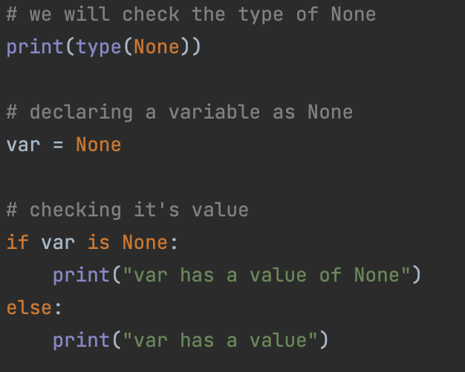
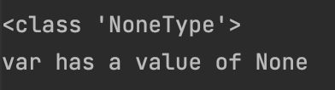
What is None?
None is used to define a null value
It is not the same as an empty string, False, or a zero. It is a data type of the class NoneType object
Output:

Slide 17



+380982759822 viktoriia-dvornyk
VikaDvornyk
Viktoriia Dvornyk
Github:

Slide 18


Thank you!
beetroot.academy

